Slide 1
CMPE 257 - Wildfire Prediction Using Machine Learning
Project Progress Presentation

Slide 2
Team
Shalu Rani (012565046)
Nasrajan Jalin (013784420)
Akshay Kumar Gyara(013836277)
Nithya Kuchadi(013769665)

Slide 3
Introduction
Wildfires are the most destructive and dangerous accidents that occur across the US especially in California.
The numbers of catastrophic wildfire incidents are increasing every year causing a lot of damage to the environment, lives, and property.
Wildfires are both difficult to fight and predict.
Combination of fire, vegetation, climate, humans, and weather make it difficult to predict where wildfires might start and how they may spread

Slide 4
Scope of the Presentation
Project Status Report:
This presentation discusses the status of the project and covers the following aspects:
Dimensions Used
Selected Models and justification
Data Preparation and training
Results

Slide 5
Dimensions Used
Weather data : During summers large quantities of dried leaves, grass, deadwood, and small plants fuel the fires in the forest. The wind and the terrain are also key factors that help in spreading the fire across the forest. Relative humidity readings and air temperature forecasts are general conditions that can be an indication of fire danger across the entire fire ground.
Satellite Data: As satellite data covers large areas and helps in the identification of extremely large features, it helps in giving a bird’s eye view for early detection and prediction of fire. Real-time predictions can be made using satellite images.

Slide 6
Dimension 1 - Weather
The goal in scope is to provide data analytics and insights into the relationship between weather and the possibility of wildfire at San Diego County.
The frequency of large wildfires is influenced by a complex combination of natural and human factors. Temperature, terrain slope, relative humidity, wind speed, and vegetation (fuel density) are important aspects of the relationship between fire frequency and ecosystems.

Slide 7
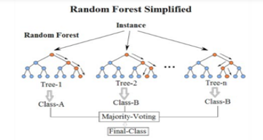
Model 1 - Random Forest
Random Forests require almost no input preparation. They can handle binary features, categorical features, numerical features without any need for scaling.
Random Forests perform implicit feature selection and provide a pretty good indicator of feature importance.
Random Forests are very quick to train. The random feature sub-setting that aims at diversifying individual trees, is at the same time a great performance optimization.
Random Forest are not very sensitive to hyper-parameters
Random Forests can be easily grown in parallel. The same cannot be said about boosted models or large neural networks.

Slide 8
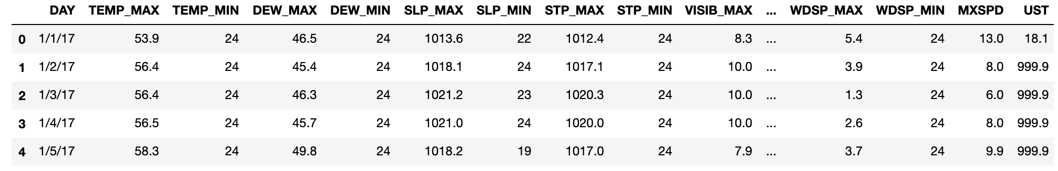
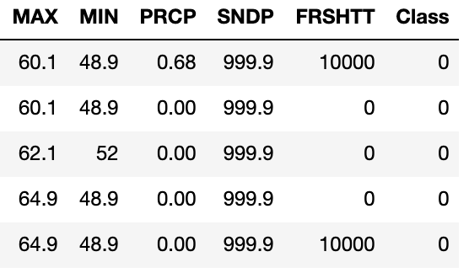
Input Data
Input data : Year 2017’s data was taken as input.
Factors influencing the trigger of fire: temperature, dew, slope, visibility(fog, smoke, smog), wind speed, precipitation, pressure etc.

Slide 9
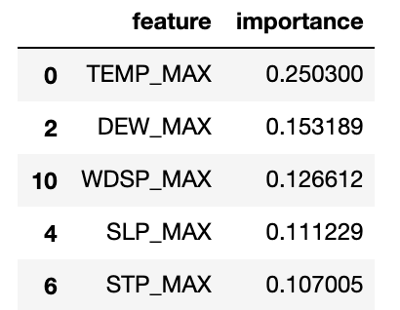
Pre Processing
Missing Values: Missing values were handled by using the mean value strategy.
Normalization: sklearn’s Normalizer was used for normalization.
The following features were found to be most important for correlation:

Slide 10
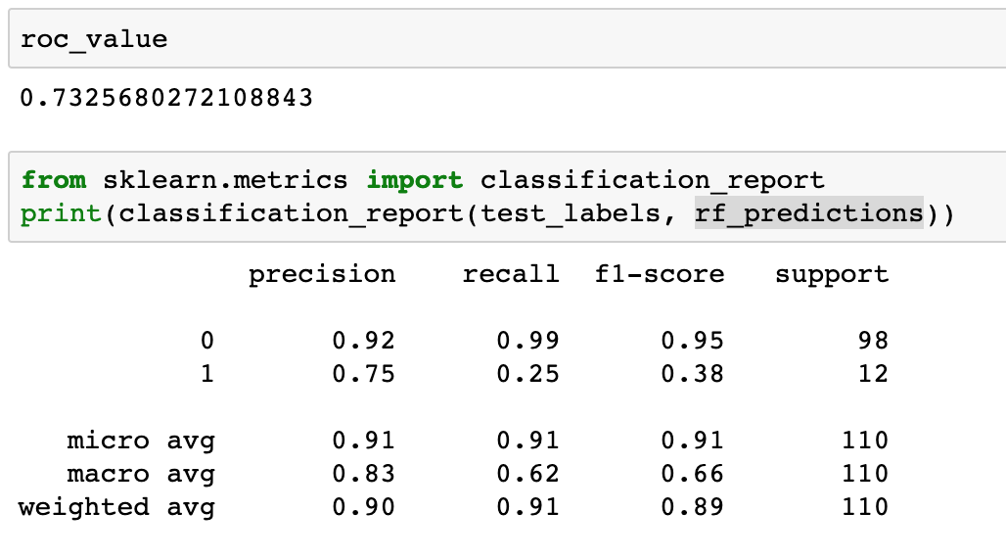
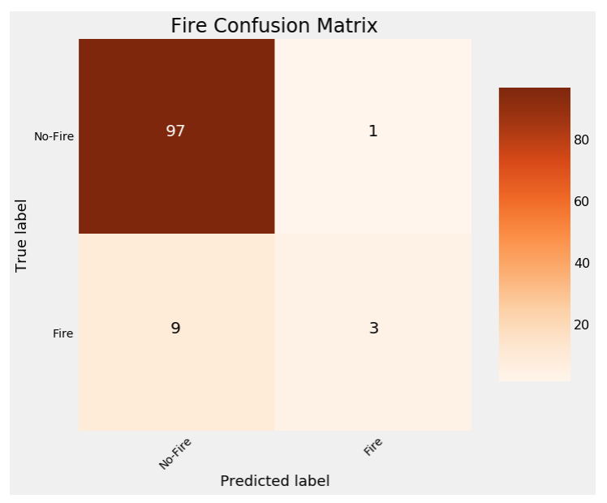
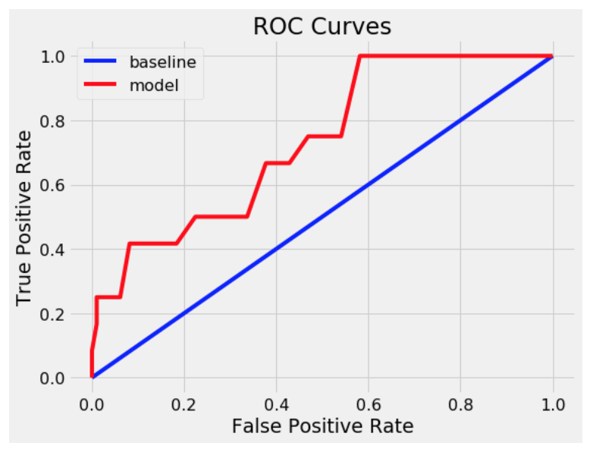
Output and Plots

Slide 11
Model 2 - Logistic Regression
Logistic regression is a statistical method for predicting binary classes. The outcome or target variable is dichotomous in nature. Dichotomous means there are only two possible classes.
For this project Logistic regression will be most appropriate as we will be going to probability of Fire/NoFire in a specific region.

Slide 12
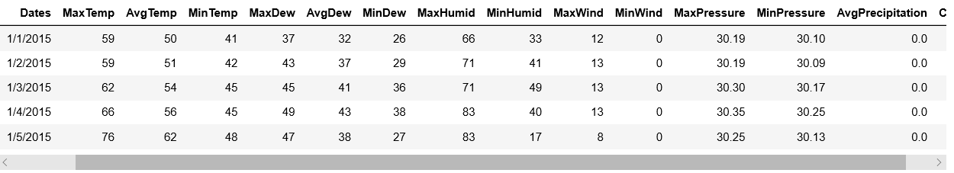
Logistic Regression - Input Data
We have collected the historic weather data from various source like www.climate.gov and National Center for Environmental Information.
We have 2 years weather data for San Diego county which has the below attributes.
'Dates', 'MaxTemp', 'AvgTemp', 'MinTemp', 'MaxDew', 'AvgDew', 'MinDew', 'MaxHumid', 'MinHumid', 'MaxWind', 'MinWind', 'MaxPressure', 'MinPressure', 'AvgPrecipitation', 'Class'

Slide 13
Logistic Regression - Pre Processing
First step is usually importing the libraries that will be needed in the program.
Import the dataset and read it using a method called read_csv which can be found in the library called pandas.
Some data are missing in the dataset so we used Imputer which will help us take care of the missing data.
we split dataset into Training set and a Test set in ratio of 70:30

Slide 14
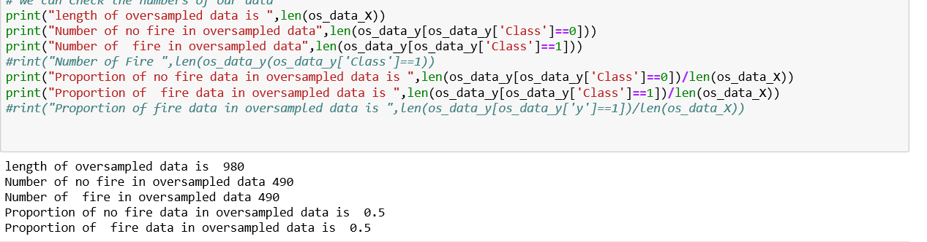
Logistic Regression - Pre Processing
5. Used SMOTE Algorithm (Synthetic Minority Oversampling Technique) for sampling the data.

Slide 15
Why Logistic Regression?
It is more robust: the independent variables don’t have to be normally distributed, or have equal variance in each group
It does not assume a linear relationship between the input and output variables
It can handle nonlinear effects.
There is no homogeneity of variance assumption.
Normally distributed error terms are not assumed.
It does not require that the independents be an interval.
It does not require that the independents be unbounded.

Slide 16
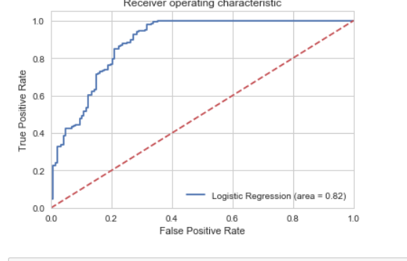
Output and Plots

Slide 17
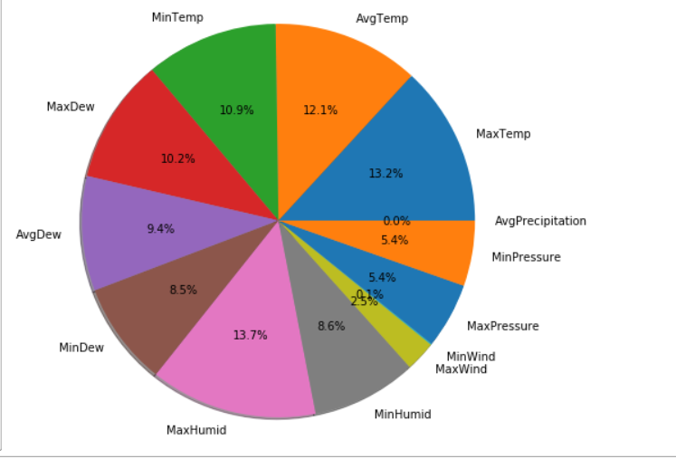
Statistics
This Pie Chart show how different attribute attribute affect wild fire .

Slide 18
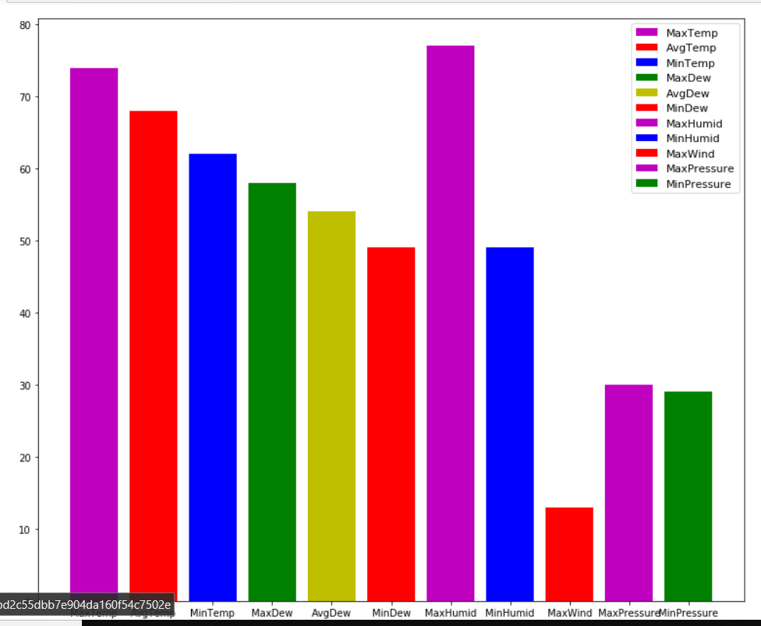

Slide 19
Dimension 2 - Satellite Images
The fire prediction is handled by early detection of smoke and very small flames
One model for localized detection and one model for validating the classification connected together using ensemble methods.
Collected smoke and flame images from MODIS and LandSat satellites for San Deigo location.
The images are in either png or jpeg format.
There are a total of 1200 training images (1000 positive, 200 negative), and 800 test images, coming out to a total of 2000 images. The training images account for 60% of all the data, and the test images account for the remainder 40%.

Slide 20
CNN-MODEL SELECTION JUSTIFICATION
This model is used for the prediction of fire in the satellite images.
CNNs work well with data having spatially recurring patterns i.e.,images, speech.
CNNs are able to learn relevant features from an image at different levels similar to a human brain.
Works well with large amount of data
Gives good accuracy in image recognition problems
Most of the other machine learning and AI algorithms do not work well for large amount of image data.

Slide 21
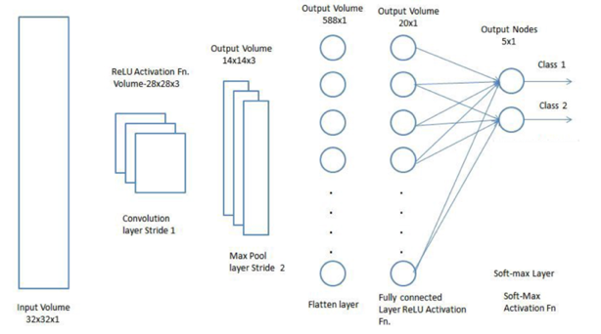
CONVOLUTIONAL NEURAL NETWORK

Slide 22
MODEL TRAINING PROCESS
1. Generated standard image and label files for each json file by using the command “labelme_json_to_dataset img.json -o img_json”
Each json file is associated with these 5 files:
•info.yaml
•img.png
•label_names.txt
•label_viz.png
•label.png

Slide 23
MODEL TRAINING PROCESS
2. Converted the images(label_viz.png) to a numpy array.
3. Converted labels(extracted from label_names.txt)to numpy arrays
def label_img(word_label):
if word_label == 'fire': return np.array([1, 0])
elif word_label == 'smoke' : return np.array([0, 1])
elif word_label == 'no fire': return np.array([1, 1])
4. Built a convolutional neural network model with 5 layers and used Relu activation function.

Slide 24
MODEL TRAINING PROCESS
5. Trained the model using images and labels by varying the batch size and no of epochs
6. Tested the model with test data for a small dataset and achieved an accuracy of 76%.

Slide 25
Model 4 - Faster R-CNN
The purpose of this model is to pinpoint the location of the fire in a map using localized detection.
Faster R-CNN is used for the localized detection of fire and smoke in the satellite images.
Most of the object detection algorithms are observed to fail if the size of the object to be detected is very small or varying in size. This is where Faster R-CNN works well.
FR-CNN accomplishes faster object detection by employing RPN (Region Proposal Network). The feature map extracted using a ConvNet is passed through an RPN which returns object proposals.

Slide 26
Input Data
Satellite Images from LandSat and MODIS
Burnt Area Images
A small amount of aerial view images of fire

Slide 27
Labeling
The main challenge faced while labelling the images were to distinguish between cloud and smoke areas.
For accurate localization, smoke images were labelled in the background of ground or vegetation.
The smoke produced by shrub burning is almost close to gray. It means that the R, G, B components of forest smoke are very close in RGB color space. With the use of green background, smoke area can be extract effectively. In the area without smoke, the G component is higher than the R and B components with about 30 ~ 40.
In the area with smoke, the G component is gradually approaching the R and B components with the smoke concentration increasing.

Slide 28
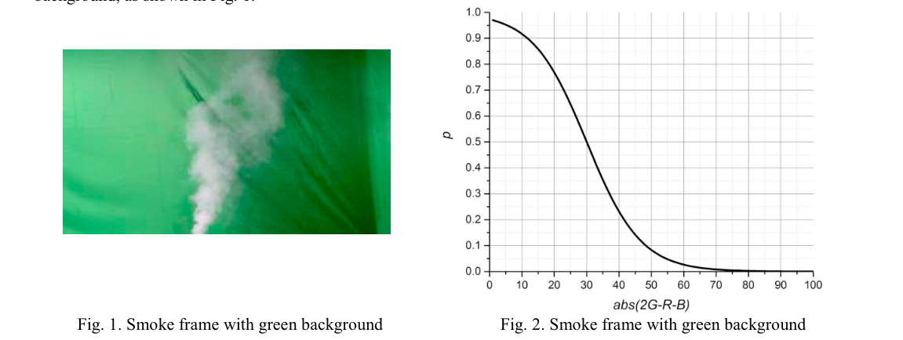
Input Data

Slide 29
Pre Processing
In order to retain all the features related to very minor smokes and fires, no regular preprocessing steps like normalization was done on the images.
Data Augmentation was done to introduce further diversity to the train data.

Slide 30
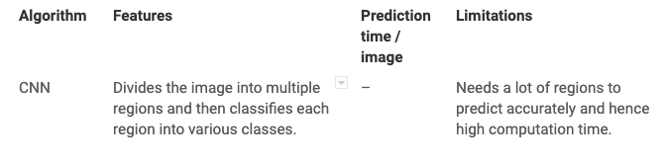
Why Faster R-CNN
Faster R-CNN has very good performance for pinpointing very small objects while segmenting and localizing.

Slide 31
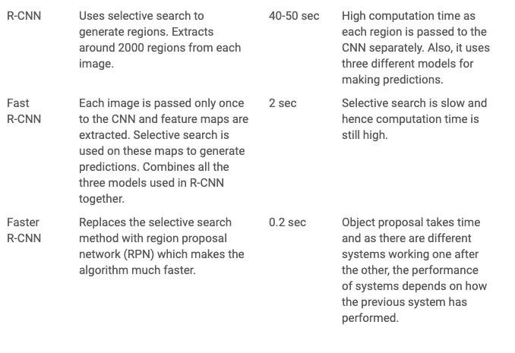
Why Faster R-CNN?

Slide 32
Other methods tried
Tensorflow Object Detection API
Heavy dependency with specific library versions
Deprecated methods
Dependency with COCO object models
Complicated to develop and maintain

Slide 33
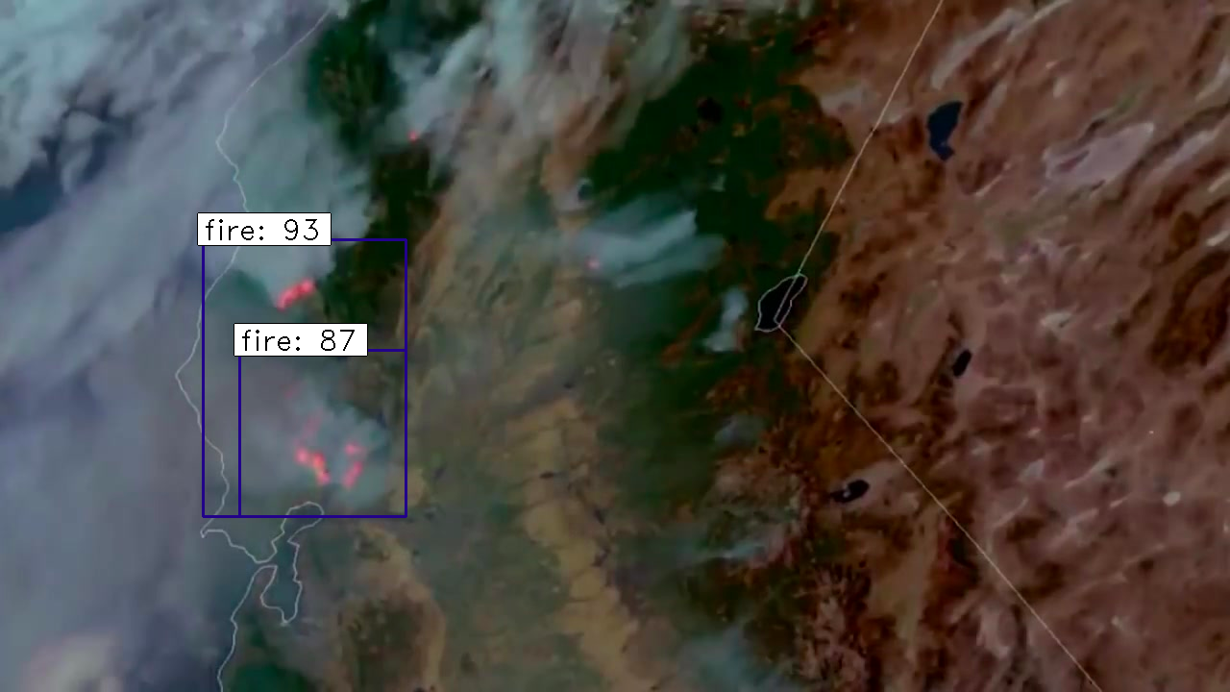
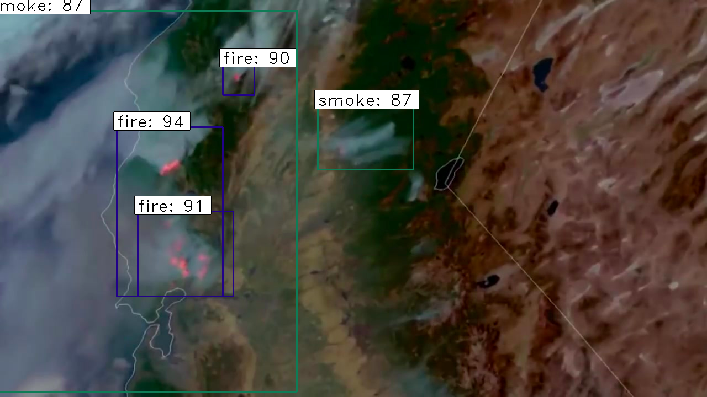
Output

Slide 34
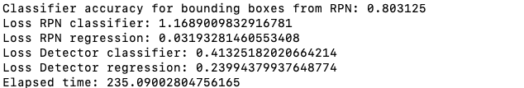
Output...contd

Slide 35
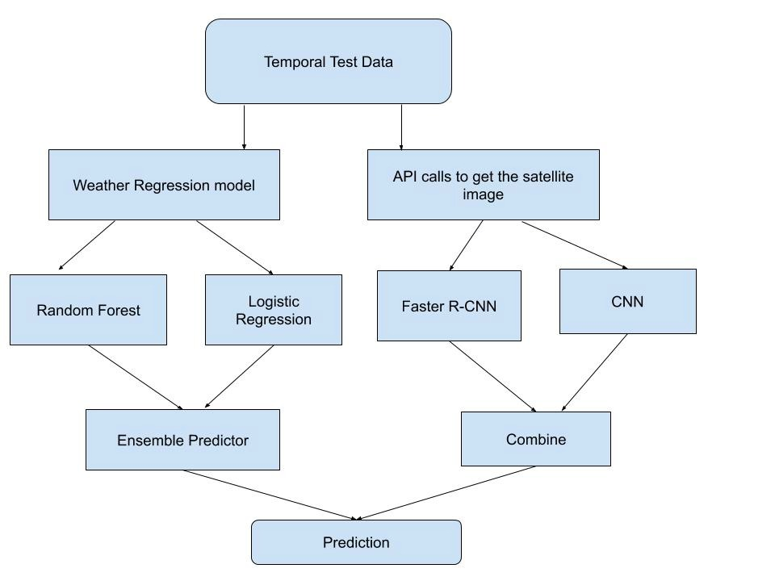
Project Workflow

Slide 36
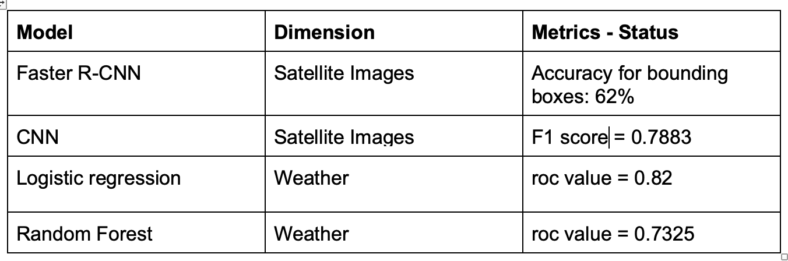
Conclusion

Slide 37
Further Research
Improve accuracy, prevent overfitting
UI
Ensemble Methods to tie the models together
API’s and regression models

